Slide 1
LOGOS AND PUNCHLINES

Slide 2
CAR LOGOS

Slide 4
FOOD AND BEVERAGE BRANDS

Slide 6
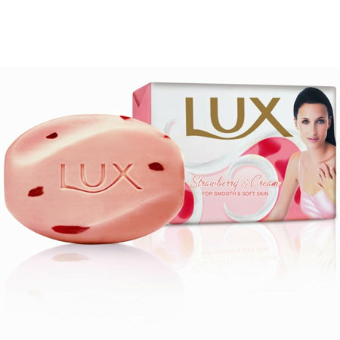
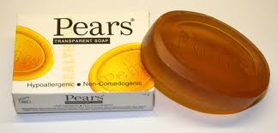
SOAP/SHAMPOO BRANDS

Slide 7
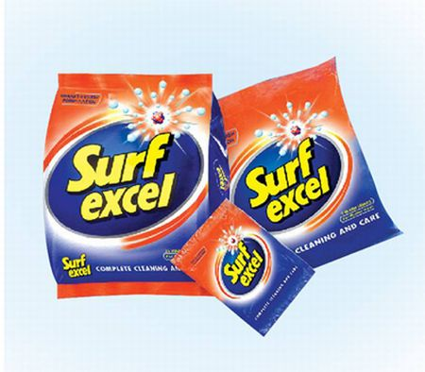
DETERGENT BRANDS

Slide 8
SHOE BRANDS

Slide 9
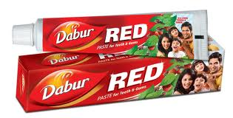
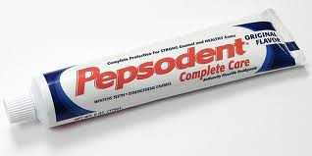
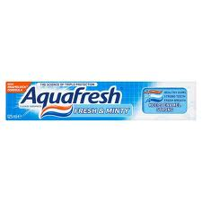
TOOTHPASTE BRANDS

Slide 10
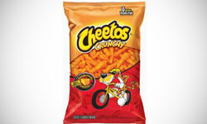
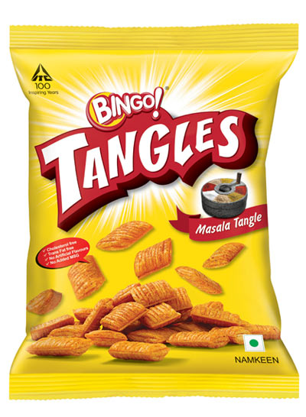
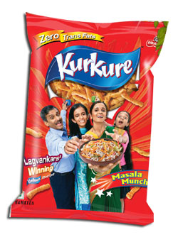
SNACK BRANDS

Slide 11
PUNCHLINES
Britannia – Eat healthy, think better.
Tata Docomo – Open up
Philips – Sense and Simplicity
Lays – Pal Banaye Magical
Center Fresh – Zubaan pe rakhe lagaam
Mountain Dew – Darr ke aage jeet hai
Sprite – Seedhi baat … no bakwaas
Amul – The Taste of India

Slide 12
PUNCHLINES
Thums Up – Taste the thunder
LG – Life’s Good
Dabur – Celebrate Life
Bangur Cement – Sasta nahi, sabse acchha
Ambuja Cement – Giant Compressive Strength
Dulux – Apna rang chhalakne do
Nerolac – Kuchh change karein, chalo paint karein

Slide 13
PUNCHLINES
Bingo – No confusion .. Great combination
Sony – Like no other
Samsung – Everyone’s invited
Big Bazaar – Isse sasta aur acchha kahin nahi milega
MRF – Tyres with muscles
CEAT – Born tough
Hyundai – Drive your way

Slide 14
PUNCHLINES
HONDA – The power of dreams
FIAT – Driven by passion
Voltas – Acs with IQ
Chevrolet – For a special journey called life

